Slide 1
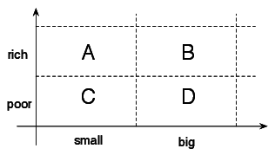





Characterization and Modelling of
Resource Usage and Energy Consumption in HPC Datacenters by Using Machine Learning
Supervisor:
Phd Fellow Xiaoyu Chu, M.Sc.
Prof. dr. ir. Alexandru Iosup
Jianyang Gu
M.Sc. @ Vrije Universiteit @University of Amsterdam
Notes:
Say Hi "In our digital age, more and more revolutionary work is supported by one critical infrastructure: High-Performance Computing datacenters."
"As we accelerate our computational capacities, we concurrently escalate our demand on resources. The power required, the energy consumed, and the better understanding/modeling become paramount concerns."
"AT the same time In our toolkit, we now have Machine Learning, with the great potential to redefine how we approach these challenges. And this brings me to the core of my research journey and what I’m excited to share with you today: TITLE NAME"

Slide 2

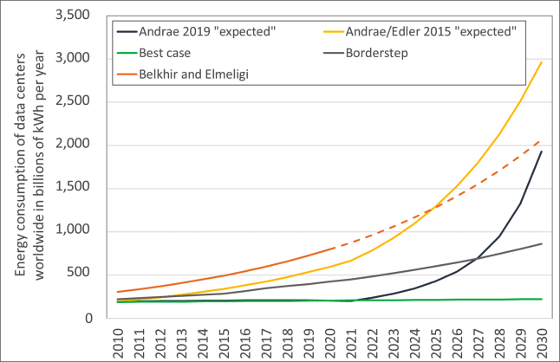
If HPC Datacenters Were a City…
+
The annual electricity use of global data centers is close to the consumption of a country like Denmark!
Still on the rise…
Key problems regarding HPC datacenters (a selection)
Optimizing data centers for a sustainable digital future
Promote awareness of ML in HPC datacenters
Gap in existing studies: lack of comprehensive & fine-grained characterization
Notes:
In this age of technological evolution, our society stands at the crossroads of transformative change. The vision of a world where individuals and human-centered organizations are enriched by an automated, sustainable layer of technology. Central to this vision are data centers. Optimizing the performance and efficiency of data centers is not just about enhancing their operational capacity. It is a commitment to creating a sustainable technological future, aligning with our broader vision of a world where technology serves humanity seamlessly.
To achieve this, there’s an imperative to grasp their dynamics fully, machine learning models thatcan foretell their operational patterns
Moreover, many data centers operate on traditional modeling, failing to capture the dynamic and evolving nature of modern data center operations. There’s a pressing need for advanced modeling and evaluates them on contemporary, large-scale, and dynamic data center infrastructures to drive the next wave of operational efficiencies. Much of the previous literature tends to focus either on a broad, overarching perspective or narrows down excessively to very specific aspects, often overlooking the multi-level granularity required for com prehensive insights.. Furthermore, while many have highlighted the importance of recognizing patterns in consumption, there’s a dearth of exhaustive research on pattern analysis for these operational matrices, which is pivotal for optimizing resources during high-demand scenarios. The scattered approach of previous studies, coupled with the lack of comprehensive multi-level analyses, signals a pressing need for an integrated research framework that captures the entirety of data center dynamics.

Slide 3
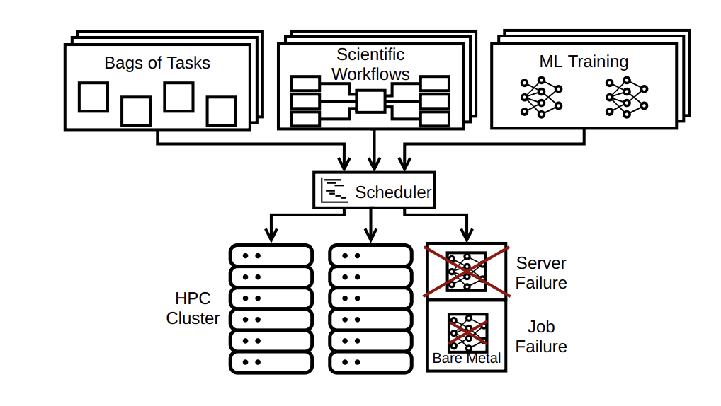
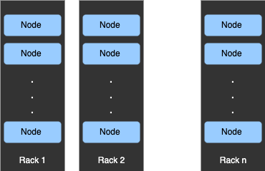
A Deep Dive into HPC Data Centers
. . .
*Source: Norman Bourassa et al. “Operational data analytics: Optimizing the national energy research scientific computing center cooling systems”
Notes:
Facilitating the rapid dialogue between these nodes, we have the Interconnect—our high-speed network
Key terms:
infrastructure, scheduler → different levels: node, rack, full datacenter
workload = jobs submitted by many different users, consume resources

Slide 4
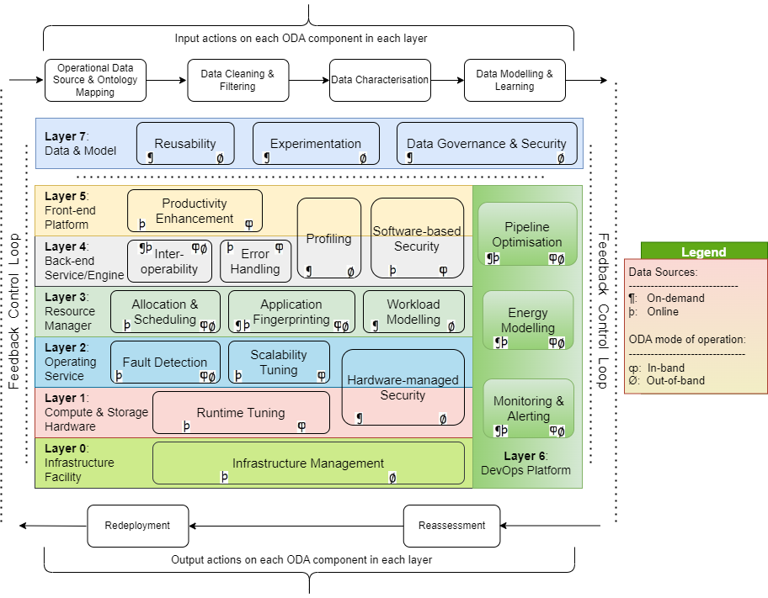
Reference Architecture for ODA
by Suman et al. (2023)
*Source: Norman Bourassa et al. “Operational data analytics: Optimizing the national energy research scientific computing center cooling systems”
Notes:
introductiohn to the reference architecture work: ODA is needed at all levels of a distributed ecosystem. We need to first understand various levels of a distributed ecosystem before presenting the requirements of an ODA framework reference architecture
where fit

Slide 5
Research Questions
*
Our primary goal is to achieve comprehensive understanding, while simultaneously introducing adaptive machine learning models that estimate and forecast resource and energy in HPC data center. Explore proactive decision-making also balancing optimal performance with sustainable practices for HPC data center.
RQ1: How to characterize and analyse resource and energy in HPC data center?
RQ2: How to design an accurate and efficient ML model for data center resource and
energy estimation and prediction?
RQ3: How to evaluate the ML models to understand resource use and energy
consumption?
Notes:
RQ1: How to Characterize and Analyse Resource and Energy?
This research question aims to unravel resource and energy characterization with a focus on CPU utilization and power usage, both crucial for subsequent analytical and predictive endeavors. The inherent challenge here lies in achieving a detailed and precise characterization of resource and energy consumption patterns in the dynamic landscape of data center operations.
Proper characterization and analysis of resource and energy usage pave the way for efficient data center management. Addressing this question ensures that computational resources are used effectively, resulting in cost savings, reduced energy consumption, and enhanced operational efficiency. This forms the foundation for all subsequent optimizations and predictive strategies.
RQ2:
How to Design An Accurate and Efficient ML Model for Data Center Resource and Energy Estimation and Prediction?
Venturing into the architecture and design of ML models tailored to the specific demands of data center operations, this research question confronts the challenge of developing models that are accurate, adaptable, and efficient. The ever-evolving nature of data centers adds complexity, requiring models that address challenges like latency, scalability, and real-time adaptability.
An optimal ML model tailored for data centers has the potential to forecast computational needs, thereby preempting system failures and inefficiencies. Predictive capabilities can lead to smoother operations, fewer outages, and more streamlined energy consumption. Addressing this question aids in navigating the complexities of modern data centers by offering proactive solutions rather than reactive fixes.
RQ3: How to Evaluate the ML Models to Understand Resource Use and Energy Consumption?
Central to this research question is the formulation of apt evaluation metrics and methodologies tailored for ML models in the context of data center dynamics. The challenge here transcends mere accuracy metrics, diving into model adaptability, and the ability to offer actionable insights. Crafting a reliable and relevant evaluation framework that can holistically assess a model's performance within the specificities of vast computing infrastructures is of paramount importance.
Evaluating ML models goes beyond mere accuracy; it determines the applicability and relevance of the model in real-world scenarios. Understanding how a model performs under varying conditions, and if it provides actionable insights, is crucial for operational success. Addressing this question ensures that the developed models align with the practicalities and intricacies of data center environments.

Slide 6
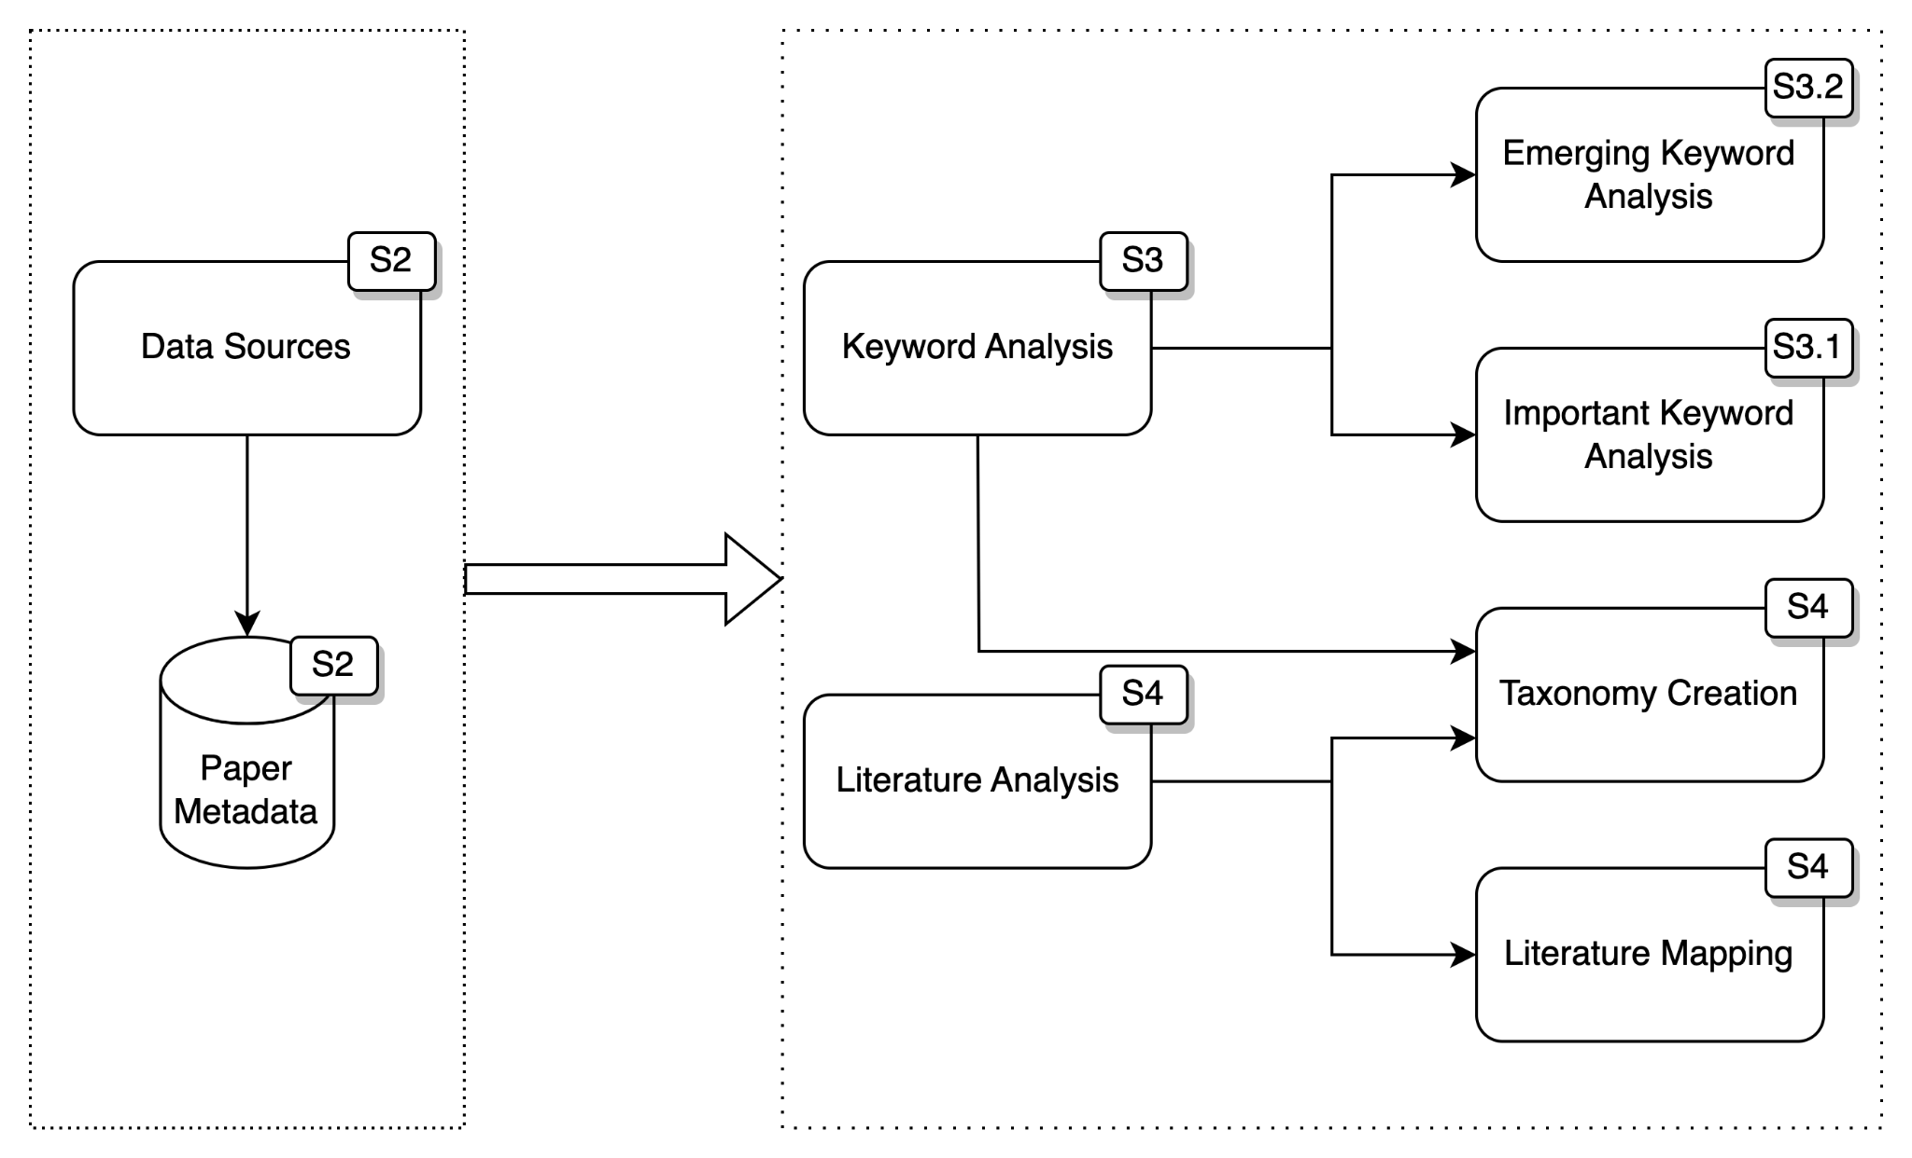
Literature Survey
*Source: Norman Bourassa et al. “Operational data analytics: Optimizing the national energy research scientific computing center cooling systems”

Slide 7
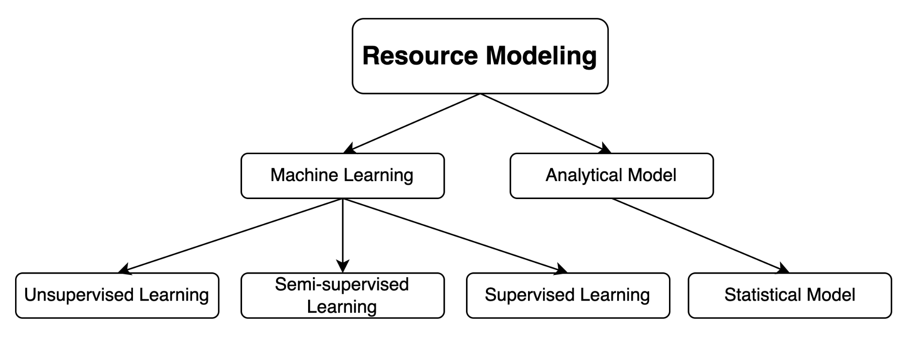
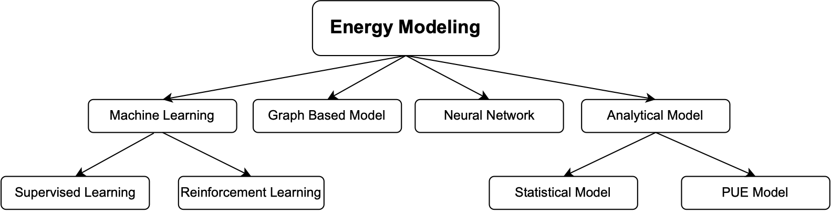
Literature Survey
*Source: Norman Bourassa et al. “Operational data analytics: Optimizing the national energy research scientific computing center cooling systems”
Notes:
Supervised Learning is a trendy way and have good preformance. Both LSTM and Transformers have shown promise in handling sequence data, as supported by numerous research studies.

Slide 8
RQ1. Characterization Overview
Dataset: LISA Data Center from June 2022 - November 2022
multi-level
fine-grained
Metrics Focus: CPU Utilization; Power Usage
Characterization Demensions:
1. Distribution in Different Granularity Levels: General Level; Rack Level; Node Level
2. Correlation
3. Temporal Dynamics
4. Pattern Analysis
We make 19 data-driven observations in the thesis
We also analyze their implications for practical use / analyze why they may happen
*Source: Literature Review: Energy-efficient techniques for Big Data processing in the 21st Century ICT Infrastructure

Slide 9
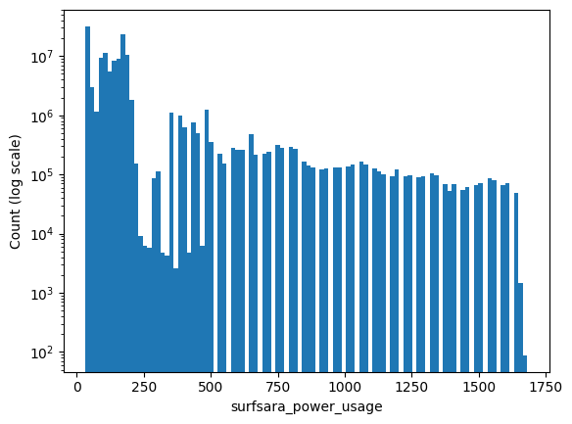
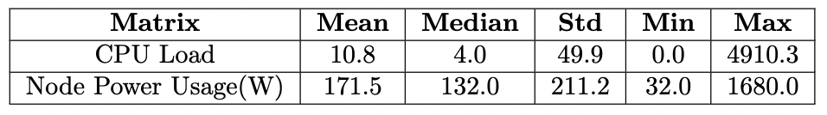
RQ1. Distribution - General Level
10^8
10^7
10^6
10^5
Count(log scale)
10^4
10^3
10^2
10^1
0 250
500
750
1000
1250
1500
Power Usage(W)
CPU Load, Power Usage distribution skews toward lower values
Both significant variability in the values
*Source: Literature Review: Energy-efficient techniques for Big Data processing in the 21st Century ICT Infrastructure
Notes:
Table and histogram The mean CPU Load is 10.8, suggesting an average CPU utilization, while a median of 4.0 indicates the CPU Load distribution skews toward lower values.
The CPU Load's standard deviation is 49.9, indicating a significant variability in the values.
The mean and median values for Node Power Usage are 171.5 and 132.0, respectively, emphasizing power consumption's concentration at the lower end.
The standard deviation for Node Power Usage is 211.2, pointing to substantial variability in power consumption among nodes.

Slide 10
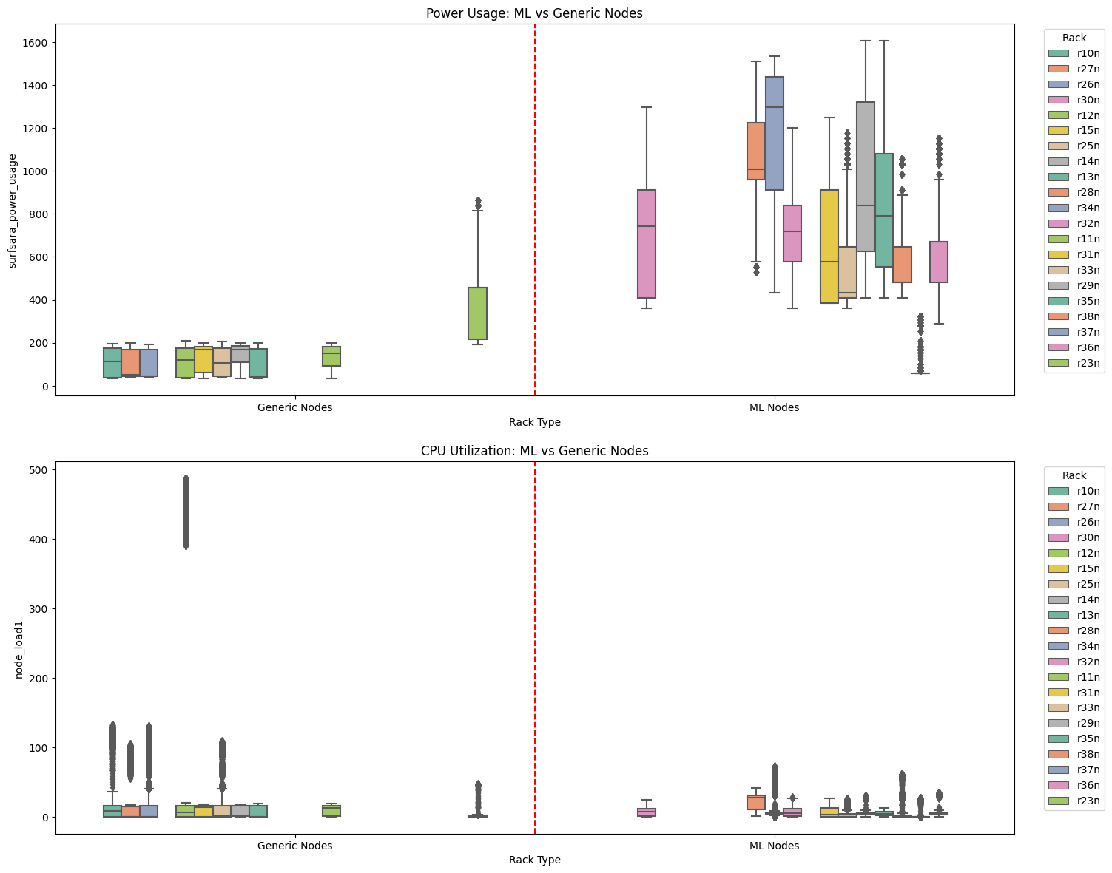
RQ1 Distribution - Rack Level
Fluctuating
Power Usage(W)
CPU Utilization(load)
Stable
Generic Rack
ML Rack
*Source: Literature Review: Energy-efficient techniques for Big Data processing in the 21st Century ICT Infrastructure
Notes:
O5: Nodes in Generic racks generally consume less power than those in ML racks, highlighting the energy efficiency of generic racks.
O6: Power usage within Generic racks is stable, indicating predictable energy performance, with rack 23 as an outlier due to its 48 CPU cores—quadruple the average.
O7: CPU utilization patterns between generic and ML racks are largely similar, indicating comparable workload demands across both types.
O8: An exception is rack 12, which has nodes with exceptionally high CPU utilization, suggesting it handles more computationally demanding tasks than other racks.
O9: ML racks have a higher temperature than Generic racks by around 3.5 °C.

Slide 11
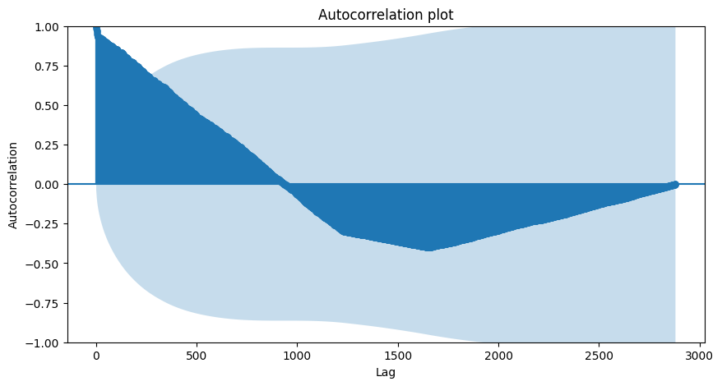
RQ1. Temporal Analysis - Auto Correlation
Timeframe & Data Points:
Duration — One day
Lag — 30 seconds
Auto-correlation for Power Usage
Key Observations:
Rapid decrease in dark blue indicates time series values primarily depend on recent observations
Autocorrelation's drop into blue shadow around 1.5 hours suggests non-significant correlations beyond this point
Lag(30s/unit)
Dark blue line: Autocorrelation coefficient for each lag.
Light blue shadow: Confidence intervals around zero.
*Source: Literature Review: Energy-efficient techniques for Big Data processing in the 21st Century ICT Infrastructure

Slide 12
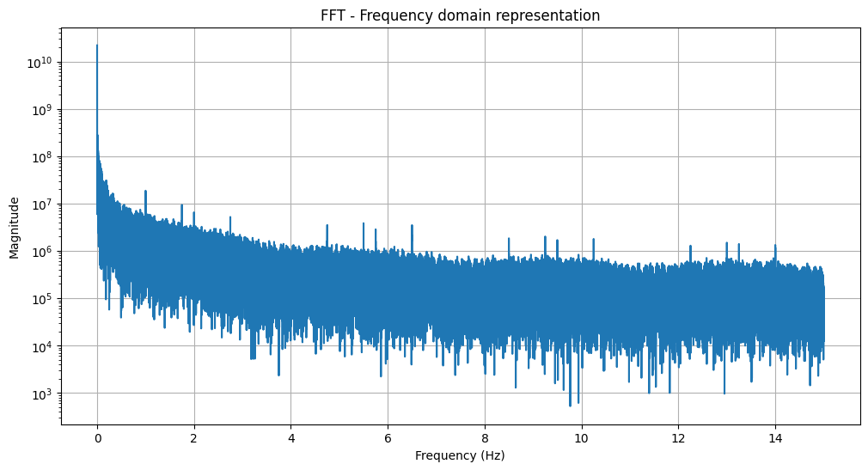
RQ1. Pattern Analysis
Methodology:
First use Discrete Fast Fourier Transform (DFFT) for frequency domain translation.
Continuous Wavelet Tree (CWT) for identifying peaks.
Top Three Patterns:
Magnititude
1st Frequency: 0.00029223886630802467 Hz
Cycle: ~1.3 days
Amplitude: 1327846457
2nd Frequency: 0.0007305971657700617 Hz
Cycle: ~0.5 day
Amplitude: 627682824
3rd Frequency: 0.0015342540481171295 Hz
Cycle: ~5.42 hours
Amplitude: 626185142
Frequency(Hz)
*Source: Literature Review: Energy-efficient techniques for Big Data processing in the 21st Century ICT Infrastructure

Slide 13
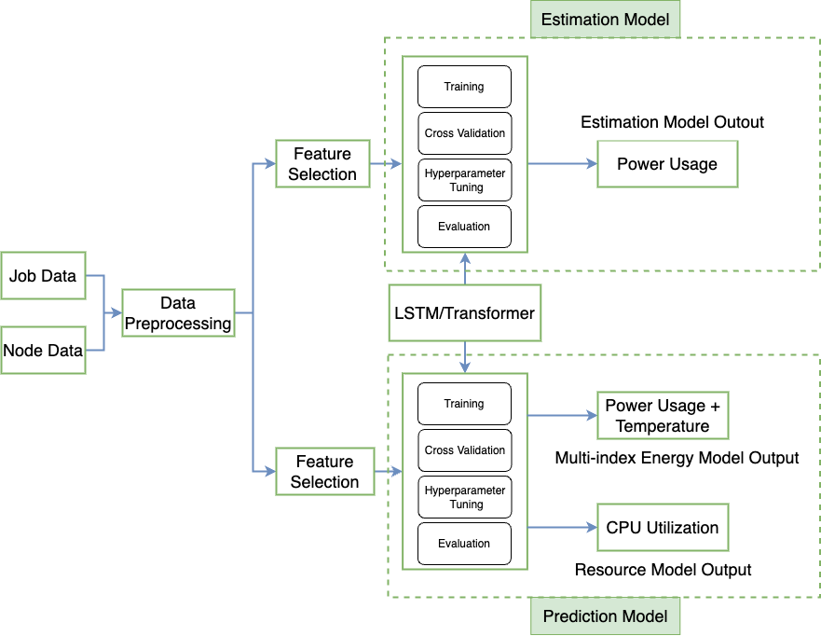
RQ2. Modeling Design
Model Selection:
LSTM
Transformer
Key Reasons:
Temporal Dependencies
Complexity of Relationships
Scalability
Complementary Strengths
*Source: Literature Review: Energy-efficient techniques for Big Data processing in the 21st Century ICT Infrastructure
Notes:
\item \textbf{Temporal Dependencies:} Both LSTM and Transform models excel at modeling sequences, crucial for time series data. LSTMs, with their unique memory cell structures, can remember and retrieve information over long intervals, making them adept at capturing long-term dependencies in time series data. Transform models, on the other hand, use attention mechanisms that weigh the importance of different time steps, allowing them to discern and prioritize crucial patterns over others.
\item \textbf{Complexity of Relationships:} The nonlinear nature of CPU utilization and power consumption requires models that can capture intricate relationships. LSTM and Transform models are inherently nonlinear, offering an edge in modeling the complex interplay of variables in our data.
\item \textbf{Scalability:} As data centers grow and the volume of data surges, scalability becomes paramount. Transform models, particularly, have showcased remarkable scalability, handling large datasets with ease, while LSTMs can be efficiently trained with the right optimizations.
\item \textbf{Complementary Strengths:} While both models are strong contenders individually, they possess complementary strengths. LSTMs thrive in scenarios where sequential memory is vital, while Transform models leverage their attention mechanisms to capture better the specific impactful events. This makes the comparison between their performances even more riveting, as it can shed light on which attributes of the data are more predictive.

Slide 14
RQ2. Experiment Design
Setup:
Evaluation Matrix: RMSE & Relative Error
Data Source: LISA system dataset
Timeframes:
June 2022 - November 2022
January 2020 - August 2020
Procedure:
Data Preprocessing
Model Building
Model Training
Model Evaluation
Hypeparamerter Tuning
Result Analysis
*Source: Literature Review: Energy-efficient techniques for Big Data processing in the 21st Century ICT Infrastructure

Slide 15
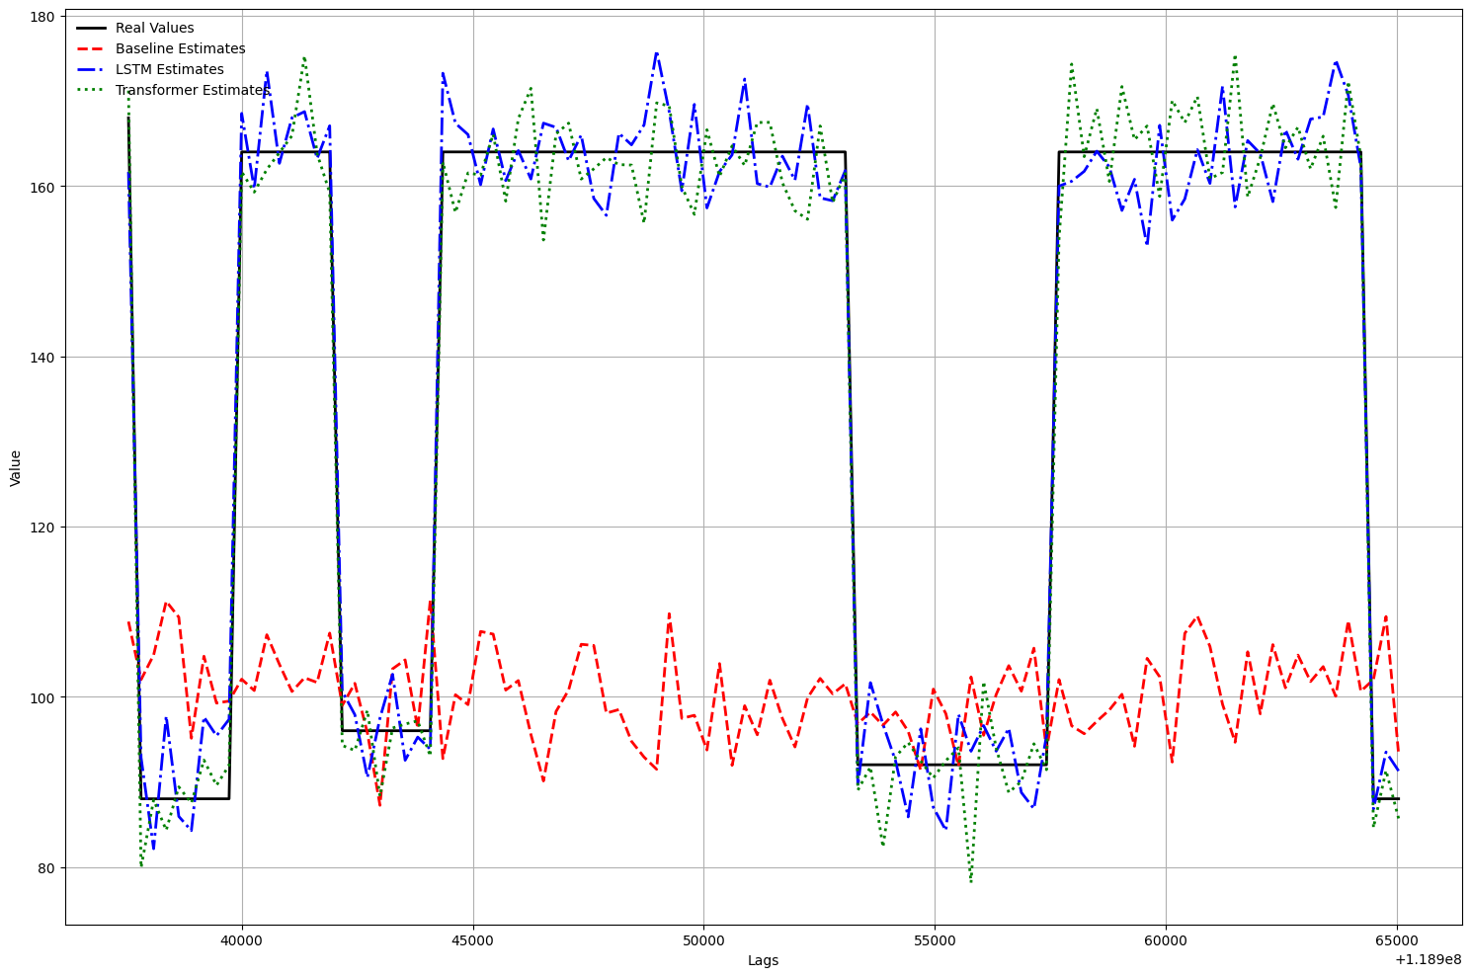
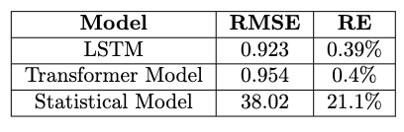
RQ3. Experiment Results - Estimation
Power Usage(W)
lags(30s/unit)
Snippet comparison of Power Usage Estimations: Baseline, LSTM, and Transformer Models
*Source: Literature Review: Energy-efficient techniques for Big Data processing in the 21st Century ICT Infrastructure

Slide 16
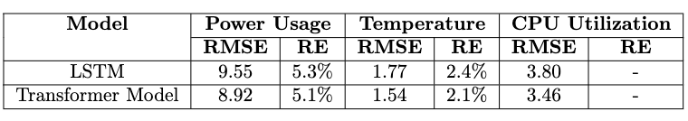
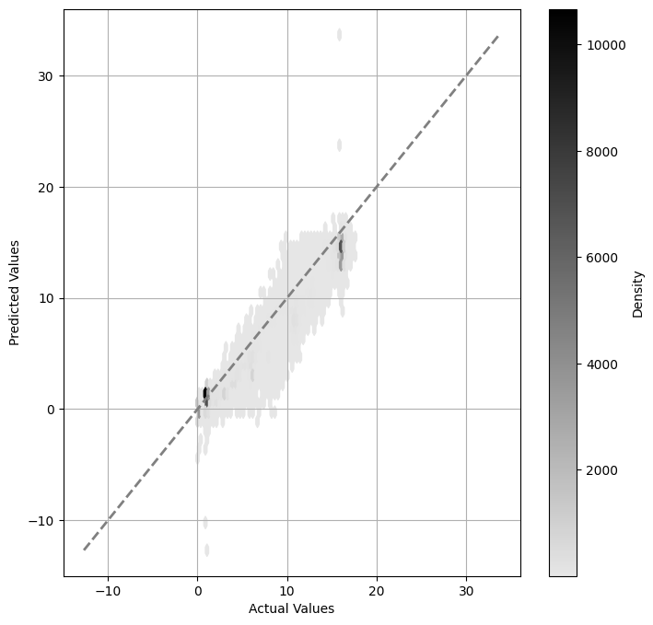
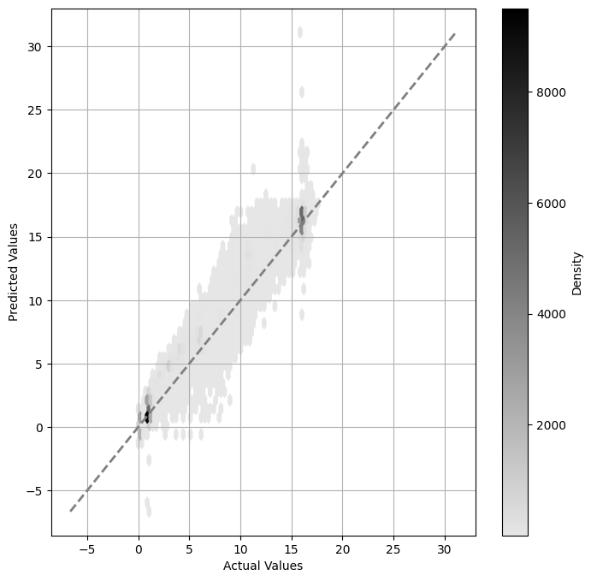
RQ3. Experiment Results - Prediction(4 steps)
Transformer
LSTM
Predicted Values
Predicted Values
Density
Actual Values
Actual Values
*Source: Literature Review: Energy-efficient techniques for Big Data processing in the 21st Century ICT Infrastructure

Slide 17
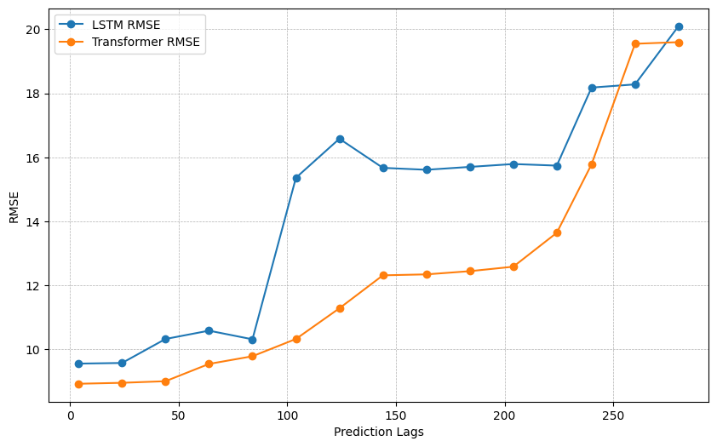
RQ3. Experiment Results - Different Prediction Time Steps
10 12 14 16 18 20
RMSE
0 50 100 150 200 250
Prediction Lags(30s/unit)
*Source: Literature Review: Energy-efficient techniques for Big Data processing in the 21st Century ICT Infrastructure

Slide 18
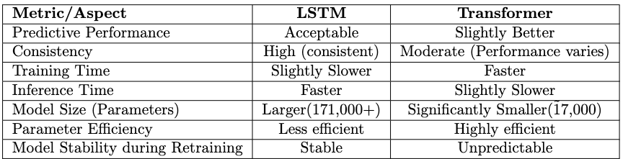
RQ3. Empirical Model Comparison – Synthesis
Transformer:
Effective self-attention mechanism and captures longer dependencies. Suited for extended predictions.
LSTM:
Consistent performance. Suited for continual retraining without loss of robustness
*Source: Literature Review: Energy-efficient techniques for Big Data processing in the 21st Century ICT Infrastructure
Notes:
Our examination of performance across various time steps suggests that the Transformer’s inherent self-attention mechanism might be adept at capturing and leveraging longer dependencies within the data. This capacity makes the Transformer particularly suited for scenarios requiring predictions across extended steps. Consequently, when the task necessitates longer-term forecasting or when the data’s dependencies span across extended intervals, the Transformer emerges as a more favorable choice compared to models without such attention-based capabilities. At the same time, in our context of forecasting energy and resource consumption, the capacity to continually retrain with fresh data — without compromising the robustness of a previously high- performing model — is paramount. Given that the reductions in parameters didn’t significantly enhance the training speed, the inclination would still be toward the reliability of the LSTM. Consequently, given its consistent performance and efficiency, the LSTM’s reliability stands out as particularly suited to our specific requirements.

Slide 19
Contributions & Future Work
RQ1: How to Characterize and Analyse Resource and Energy?
C1. Comprehensive characterization and analysis of resource and energy consumption, from broad overviews to detailed rack-level insights, highlighting three key patterns.
RQ2: How to Design An Accurate and Efficient ML Model for Data Center Resource and Energy Estimation and Prediction?
C2. Design of LSTM and Transformer models that surpass current statistical methods in accuracy for estimation, and explore multi-step predictions in CPU utilization and power consumption.
RQ3: How to Evaluate the ML Models to Understand Resource Use and Energy Consumption?
C3. Detailed evaluation of LSTM vs. Transformer in HPC settings, providing clarity on their best applications for sustainability and efficiency.
Original Contribution: Comprehensive characterization on multi-level, fine-grained dataset; Analysis spanning multiple levels (node, rack, overview); Employment of frequency domain analysis for enhanced pattern detection; ML model comparison and insights into HPC data center
Future Work: Conduct simulation experiments in real world; Proactive resource and energy scheduling harnessing estimation and prediction a algorithms for optimized HPC operations
Notes:
challenge: The inherent challenge here lies in achieving a detailed and precise characterization of resource and energy consumption patterns in the dynamic landscape of data center operations
the challenge here transcends mere accuracy metrics, diving into model adaptability, and the ability to offer actionable insights
Interesting point:

Slide 20
Back up Slides

Slide 21
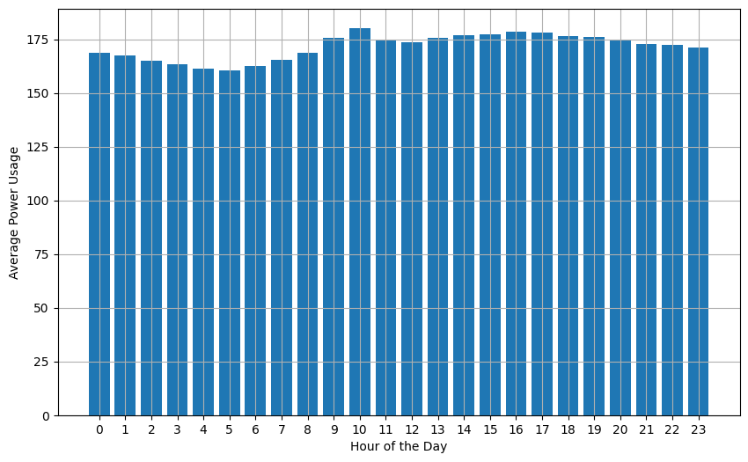
RQ1. Temporal Analysis
Diurnal Presence
Morning Peak
Dawn Dip
Daytime Demand
Evening Easing
Average Power Usage(W)
Hour of the day
*Source: Literature Review: Energy-efficient techniques for Big Data processing in the 21st Century ICT Infrastructure
Notes:
Firstly, we recognize a pronounced diurnal pattern. This means that the power usage across all nodes follows a predictable day-night cycle.
Zooming into specifics, we note a peak in consumption at 10 am. This could be attributed to the start of many computational tasks, or perhaps aligns with general business operations.
Contrarily, the wee hours of dawn, at 5 am, see the least power draw. A period of respite, if you will.
An interesting trend emerges during the day. From 9 am stretching to 7 pm, we observe a sustained high power consumption phase. This could be interlinked with regular business hours or an uptick in computational activity during this duration.
As day turns to evening, there's an evident tapering in power consumption, eventually descending to its lowest point again at 5 am. Recognizing such patterns can be monumental for us, as they pave the way for informed decisions about load balancing and energy conservation initiatives, especially during these quieter consumption periods."

Slide 22
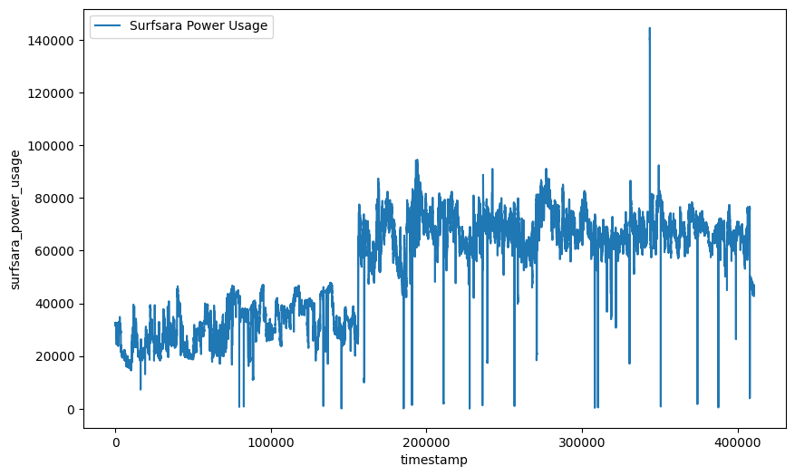
RQ1.
*Source: Literature Review: Energy-efficient techniques for Big Data processing in the 21st Century ICT Infrastructure
Notes:
The DFFT is utilized primarily to convert a signal from its original time domain to a representation in the frequency domain. In the context of HPC data centers, there's a need to discern periodic patterns or cycles that may not be apparent in raw time series data.
The DFFT captures the frequency components of a time-series data, thereby showing how different frequencies (or periodic patterns) contribute to the overall behavior of the system. This provides insights into recurring events or patterns in the data.
After applying the DFFT, you would obtain a spectrum showing the intensity (or power) of different frequencies in your data. Peaks in this spectrum indicate dominant frequencies (i.e., patterns or cycles) in your original data. For example, if there's a peak at a specific frequency, it suggests that there's a recurring pattern in the data at that frequency.
CWT is a powerful tool for analyzing local aspects of a signal. While the DFFT provides a global representation of frequencies, CWT is adept at locating the presence of those frequencies at different moments in time. It is especially useful for non-stationary signals where frequency components change over time.

Slide 23
RQ1. Distribution - Node Level
CPU Utilization Discrepancy:
1. Node 'r14n20'(Generic) stands out with a mean CPU load surpassing 200
2. Lowest CPU loads are primarily on nodes from racks 'r37', 'r38'(ML)
3. less CPU activity for many ML nodes
Power Usage Insights:
1. No obvious outliers in power usage; However, a significant chunk of high-power consuming nodes are in the 'r29' rack(ML)
2. 'r10n32'(Generic) showcases the least mean power usage and smallest CPU load
3. Many nodes in ‘r37’ rack(ML) have a low average power consumption
*Source: Literature Review: Energy-efficient techniques for Big Data processing in the 21st Century ICT Infrastructure

Slide 24
RQ1. Correlation
Methods: Pearson & Spearman
Interconnected Impact:
CPU utilization, power usage, and node temperature interplay
Increase in CPU usage ➔ rise in power usage & temperature
Thermal throttling(heat slowdown) & system overload adjustments can influence CPU utilization
The Feature 'node_procs_running':
Strong correlation with both CPU utilization and power consumption (> 0.6).
Indicates computational demand and energy usage implications.
*Source: Literature Review: Energy-efficient techniques for Big Data processing in the 21st Century ICT Infrastructure
Notes:
Focusing on CPU Utilization, we discerned 6 features exhibiting a potent linear relationship, while another 9 have a strong monotonic association. What's captivating is that all these features have ties to node temperature and power use.
Moving to Power Usage, a similar pattern emerges. Again, 6 features underline a significant linear bond and 9 present a robust monotonic connection. These traits inherently link back to node temperature and CPU activities.
Now, you may wonder about the statistical solidity of these observations. Our P-values are less than $5 \times 10^{-8}$, pointing towards their formidable statistical importance.
Diving deeper into the interplay between CPU utilization, power usage, and node temperature, we observed a reciprocal influence. As CPU utilization surges, there's a parallel escalation in power use and node temperature. Factors like thermal throttling can step in when temperatures skyrocket, impacting CPU activity.
A particularly standout feature is 'node_procs_running', which tallies the currently active processes on a node. Its correlation with CPU utilization and power consumption is noteworthy, highlighting the intertwined dynamics of computational requirements and energy expenditure. Recognizing the relationship between these running processes and the system’s performance can offer actionable insights into system efficiency and potential areas for optimization."

Slide 25
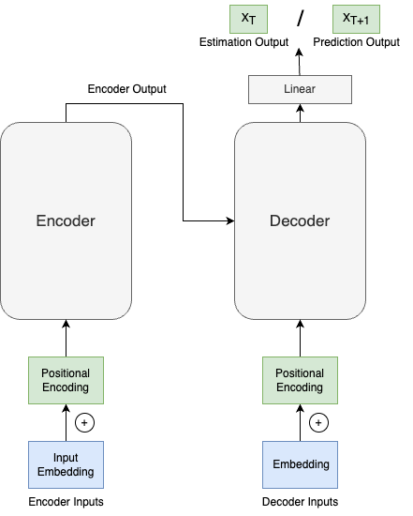
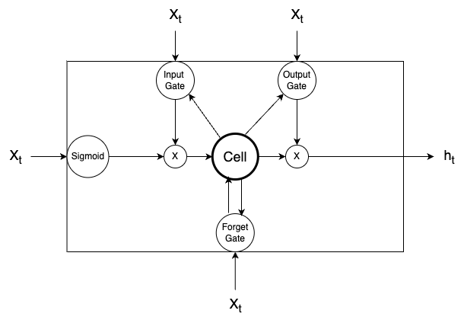
*Source: Literature Review: Energy-efficient techniques for Big Data processing in the 21st Century ICT Infrastructure
Notes:
Focusing on CPU Utilization, we discerned 6 features exhibiting a potent linear relationship, while another 9 have a strong monotonic association. What's captivating is that all these features have ties to node temperature and power use.
Moving to Power Usage, a similar pattern emerges. Again, 6 features underline a significant linear bond and 9 present a robust monotonic connection. These traits inherently link back to node temperature and CPU activities.
Now, you may wonder about the statistical solidity of these observations. Our P-values are less than $5 \times 10^{-8}$, pointing towards their formidable statistical importance.
Diving deeper into the interplay between CPU utilization, power usage, and node temperature, we observed a reciprocal influence. As CPU utilization surges, there's a parallel escalation in power use and node temperature. Factors like thermal throttling can step in when temperatures skyrocket, impacting CPU activity.
A particularly standout feature is 'node_procs_running', which tallies the currently active processes on a node. Its correlation with CPU utilization and power consumption is noteworthy, highlighting the intertwined dynamics of computational requirements and energy expenditure. Recognizing the relationship between these running processes and the system’s performance can offer actionable insights into system efficiency and potential areas for optimization."

